Slide 1

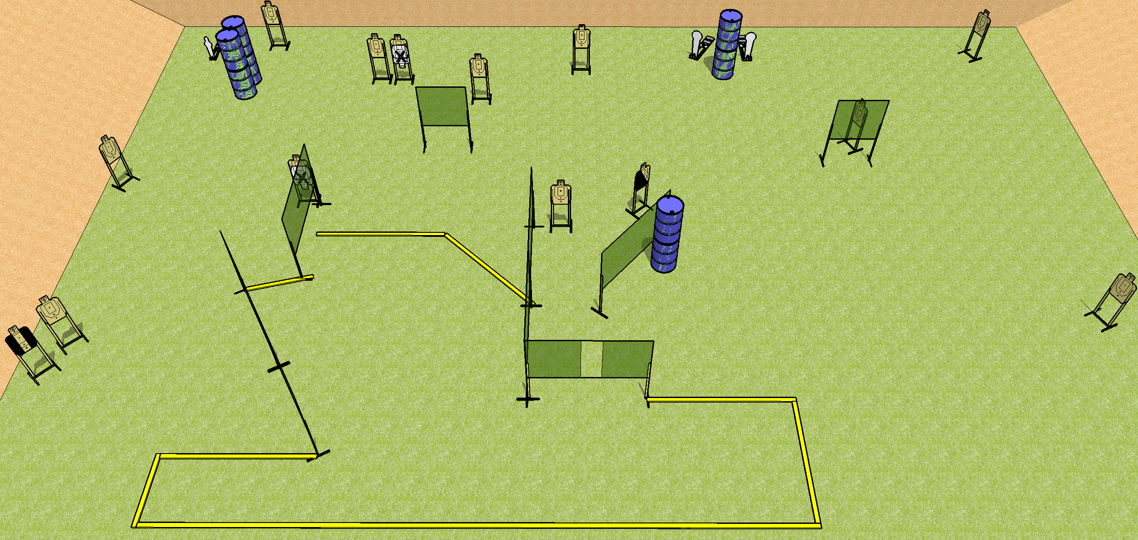
 | Dothan Practical Shooters – USPSA Match Bring It Course Designer : Drew Coleman Bay: A1
Round Count 32 rounds 14 USPSA 3 colt poppers, 1 mini popper
Equipment List 15 wall feet 1 tux, 1 left diag 14 targets (12 + 2NS)

Slide 2
Stage Name
Written Stage Briefing
Scoring: Comstock Rounds: 32
Targets: 14 USPSA, 4 steel
Handgun start position: anywhere inside the shooting area, wrists below belt. Handgun is loaded and holstered.
PCC start position: anywhere inside the shooting area, stock on belt. Loaded carbine is held with both hands, safety on.
Stage Procedure: on the audible start signal, engage targets as they become available from within the shooting area.

